Slide 1
Problem Statements
EdTech faces challenges such as inefficient data retrieval, hindering swift decision-making, and the absence of customized KPIs impacting metric tracking. A systematic approach is needed for agent pipeline analysis, and delays in student application analysis affect top management's decision-making. These inefficiencies directly impact company revenue, driving improvements for an enhanced student application journey.

Slide 2
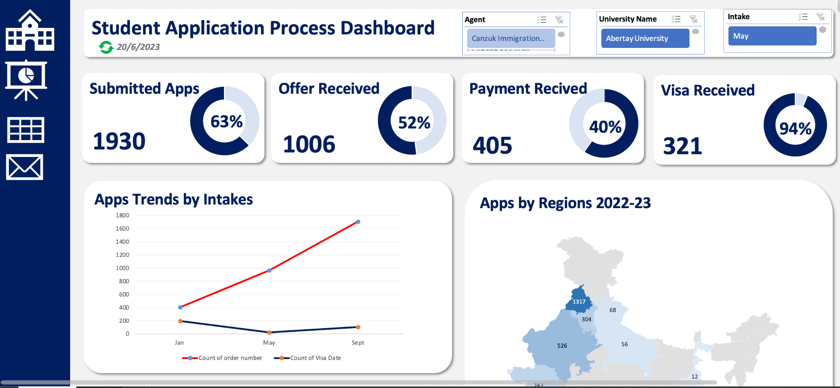

Slide 3
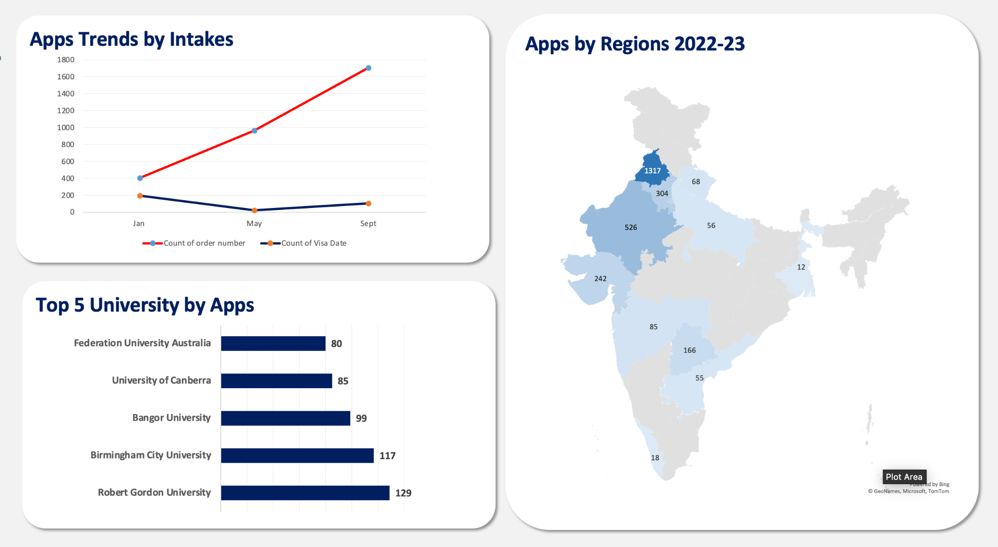

Slide 4
